Slide 1
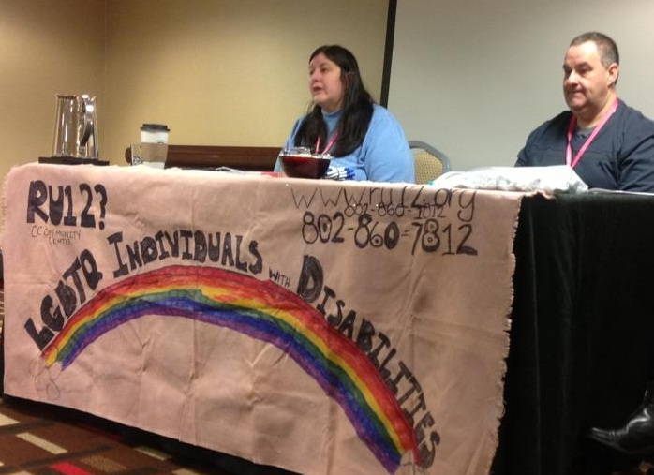
Building Bridges: Creating Spaces for Inclusion within Self-Advocacy and LGBTQ Communities
Lex Bolyanatz, MSW, & Tia Nelis, Self-Advocacy Specialist
Institute on Disability and Human Development, IL UCEDD, University of Illinois at Chicago
Introduction
What could inclusive spaces that include self-advocates and GLBTQ advocates look like?
Some Questions to Ask:
The intersecting marginal identities of self-advocates with intellectual/developmental disabilities (IDD) and individuals who identify as Lesbian, Gay, Bisexual, Transgender and/or Queer (LGBTQ) provides an opportunity for increased social support and social inclusion.
There has been very little research done on this area, and the authors suggest that through the creation of inclusive spaces, these two communities can mutually benefit from each other’s perspective.
At the self-advocacy summits that were held in 2011, a young adult with IDD came out as a lesbian in front of other self-advocates and allies. Although people were supportive, this young woman was looking for a support group that would allow her to have role models who had had similar experiences to her. Self-advocates and allies must continue to support GLBTQ self-advocates, but the GLBTQ community can and should provide unique insight from their experiences.
1. Showing up. The concrete connections that come through in-person meetings and conversations are important for building trust and getting to know who the other group members are. Within this, there should be space to identify any way you want to. Including members from both movements in each group’s is essential for true inclusivity, as Thompson (2008) has demonstrated. Also, by examining each other’s goals and things that they are working on, both groups can see where they can partner for those issues that are important to both groups.
2. Respectful honesty. Speak from your own experience and be open to the experiences of others. Language matters. Asking the question of how a person would like to be addressed is always a good idea. Being honest with yourself is the first step. From there you can be honest with others.
3. Understand supports that people may or may not need. Some people like to ask for support, where others may benefit from “support check-ins.” This is similar to the idea of “gender pronoun checks,” during which group members can offer specifics in terms of how they’d like to be addressed. Supports can appear in a variety of modes. Checking in as a group gives individuals an opportunity to explain what works best for them without being singled out.
How do people in your movement/community refer to us?
How do they think about us?
What can we learn from each other?
What is the history of your movement?
We’ve used these two movements as an example of how inclusive space can be created and anticipated. We want to acknowledge, however, that the self-advocacy movement (particularly around intellectual disability) and the GLBTQ movement are but two facets of social identity. There are other movements that have been initiated on the basis of specific oppressions, such as racism. It is important to explore multiple facets of diverse identity.
.
.
Why is this an issue?
Self-advocates have only recently been seen as being able to have a sexual identity (Hingsburger & Tough, 2002; Servais, 2006; World Health Organization, 2005).
Löfgren-Mårtenson (2009) suggested that young adults with ID were socialized to be heterosexual, and that young adults with ID might benefit from role models who are not heterosexual.
Additionally, the practice of normalization (Wolfensberger, 1972) has impacted people with IDD’s pathway to social empowerment. Culham and Nind (2003) identify an assimilationist impulse of normalization that has not made room for the celebration of differences, contrary to other groups such as the LGBTQ movements. People with IDD who may not identify as heterosexual are left out even from inclusive communities such as LGBTQ groups. This is in addition to pervasive, cross-cultural negative views of people with IDD (Allison & Strydom, 2009).
Though a few support groups have emerged that particularly serve people with IDD that identify as LGBTQ (Noonan & Taylor Gomez, 2011, Allen, 2003), more sustained supportive interaction is needed between the self-advocacy movement and the GLBTQ movement. Thompson (2008) uses queer theory to claim that true inclusionary practices (particularly in school settings) require that just as ableism is interrogated, heterosexism should also be questioned alongside it.
Green Mountain Self-Advocates (2009) have identified “Being free about your sexuality, like if you are gay, straight or lesbian,” as a component of sexual self-advocacy.
.
Tia Nelis (UIC) and David Frye (Green Mountain Self-Advocates) present at the “Creating Change” conference held in Atlanta in Spring of 2013.
Thanks to Peri Radecic for the allowing us to use this photo, and for inspiring this poster.
References
Allen, J.D. (2003). Gay, lesbian, bisexual and transgender people with developmental disabilities and mental retardation: Stories of the rainbow support group. New York: Haworth Press.
Allison, L., & Strydom, A. (2009). Intellectual disability across cultures. Psychiatry 8(9), 355-357.
Culham, A., & Nind, M. (2003). Deconstructing normalisation: Clearing the way for inclusion. Journal of Intellectual & Developmental Disability, 28(1), 65-78.
Green Mountain Self Advocates. (2009). Sexual self-advocacy. [Pamphlet]. Retrieved from http://www.gmsavt.org/wp/wp-content/uploads/2010/12/sexual_self-advocacy_pamphlet.pdf
Hingsburger, D., and Tough, S. (2002). Healthy Sexuality: Attitudes, systems, and policies. Research and Practice for Persons with Severe Disabilities, 27(1), 8-17.
Löfgren-Mårtenson, L. (2009). The invisibility of young homosexual women and men with intellectual disabilities. Sexuality and Disability, 27, 21-26.
Noonan, A. & Taylor Gomez, M. (2011). Who’s missing? Awareness of lesbian, gay, bisexual and transgender people with intellectual disability. Sexuality and Disability, 29, 175-180.
Thompson, A.S. (2008). De/centering straight talk: Queerly informed inclusive pedagogy for gay and bisexual students with intellectual disabilities. Journal of LGBT Youth, 5(1), 37-56.
Servais, L. (2006). Sexual health care in persons with intellectual disabilities. Mental Retardation and Developmental Disabilities Research Reviews, 12(1), 48-56.
World Health Organization. (2005). Disability, including prevention, management and rehabilitation. Retrieved from http://www.who.int/gb/ebwha/pdf_ﬁles/WHA58/WHA58_23-en.pdf

